Slide 1

Zomato averages 17.5 million monthly transacting customers in its food delivery business. The number of active food delivery restaurant partners on Zomato's platform has also seen an 8.7% year-on-year increase, rising from 208,000 to 226,000. As a data professional at Zomato, you have access to a customer dataset and are tasked with analyzing the data. Your responsibilities include performing Exploratory Data Analysis (EDA), creating visualizations, and answering the following questions.
Data Analysis Project Using Python
ZOMATO

Slide 2
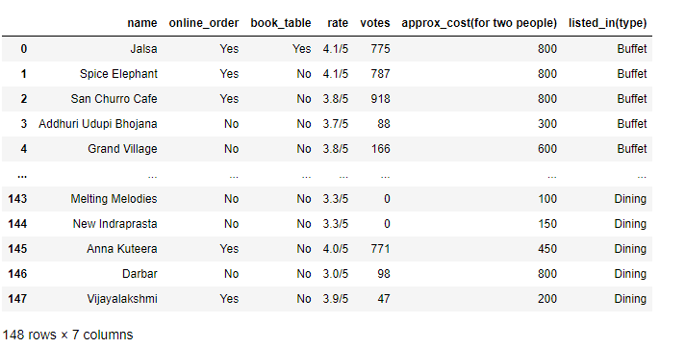
Data Analysis Project Using Python
ZOMATO

Slide 3
Data Analysis Project Using Python
ZOMATO
1) What type of restaurant do the majority of customers order from?
2 How many votes has each type of restaurant received from customers?
3) What are the ratings that the majority of restaurants have received?
4)Zomato has observed that most couples order most of their food online. What is their average spending on each order?
5) Which mode (online or offline) has received the maximum rating?
6) Which type of restaurant received more offline orders, so that Zomato can provide those customers with some good offers?

Slide 4
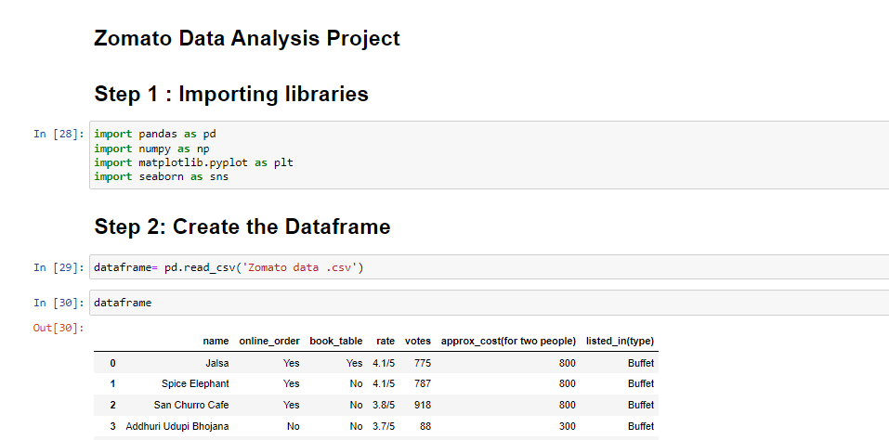
Data Analysis Project Using Python
ZOMATO

Slide 5
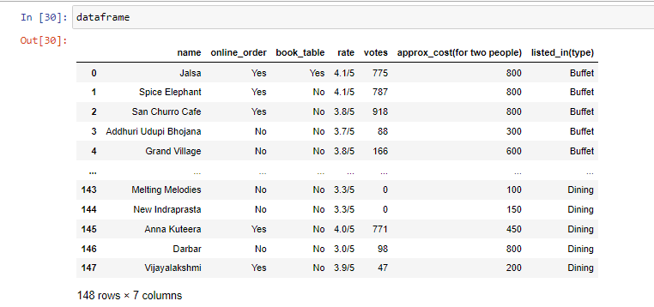
Data Analysis Project Using Python
ZOMATO

Slide 6
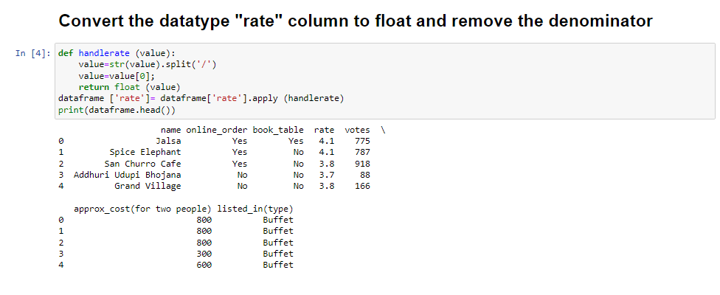
Data Analysis Project Using Python
ZOMATO

Slide 7
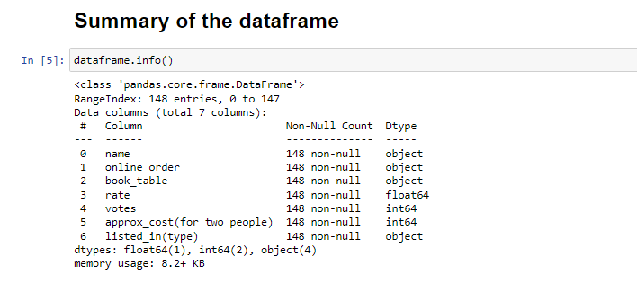
Data Analysis Project Using Python
ZOMATO

Slide 8
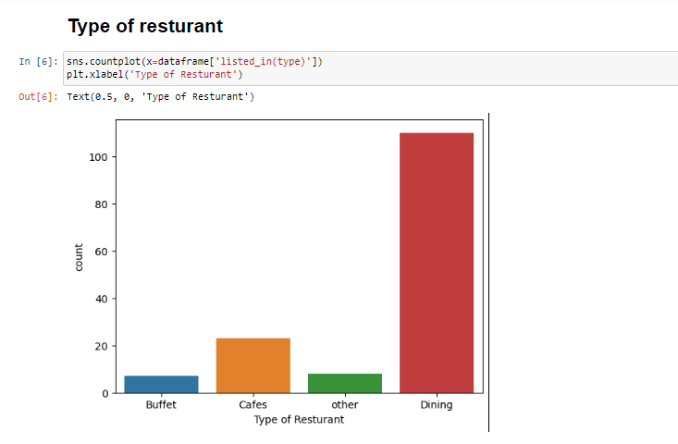

Data Analysis Project Using Python
ZOMATO

Slide 9
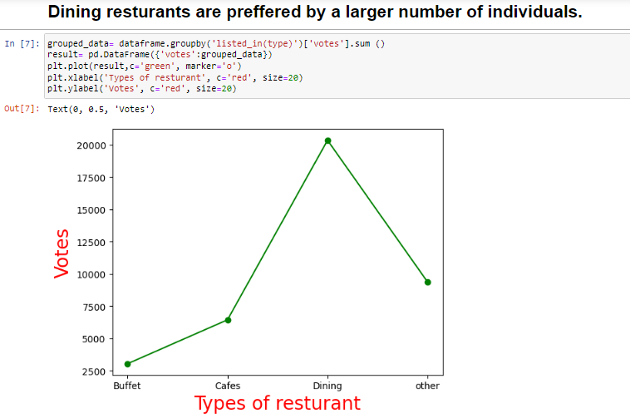
Data Analysis Project Using Python
ZOMATO

Slide 10
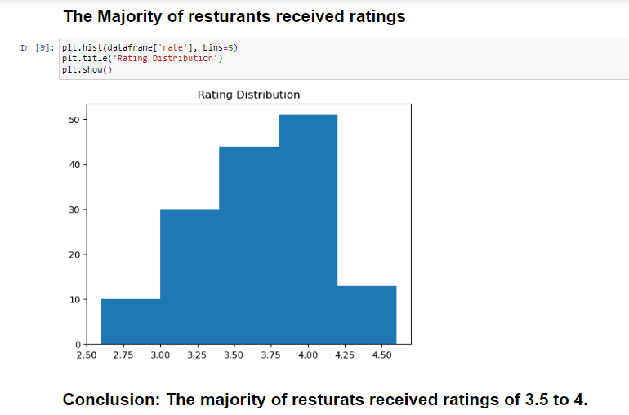
Data Analysis Project Using Python
ZOMATO

Slide 11
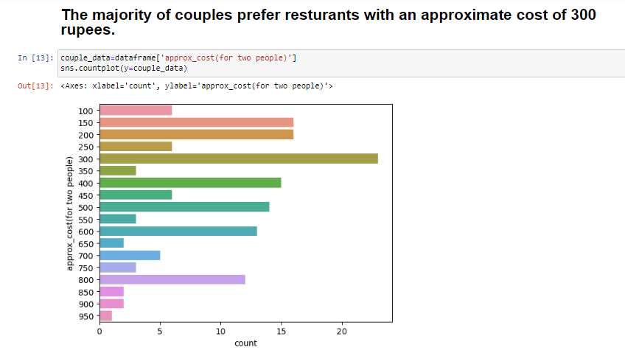
Data Analysis Project Using Python
ZOMATO

Slide 12
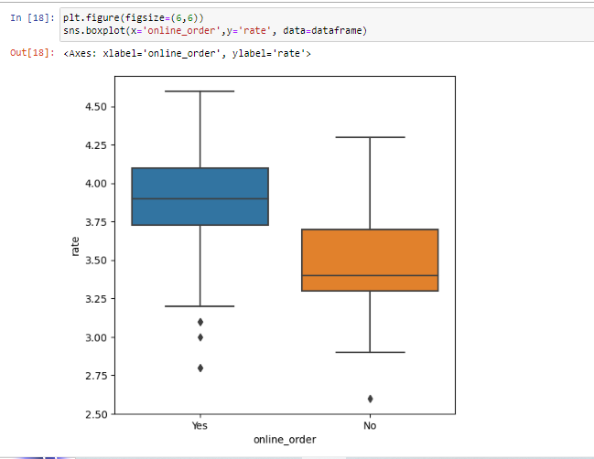
Data Analysis Project Using Python
ZOMATO

Slide 13
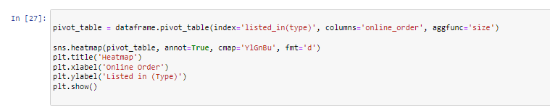
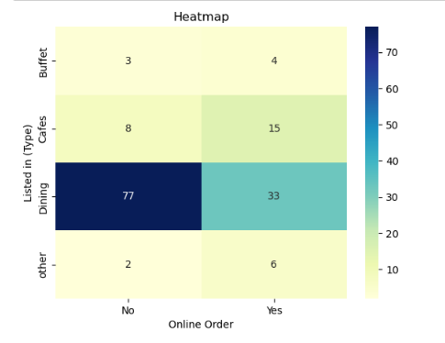

Data Analysis Project Using Python
ZOMATO

Slide 14
T
Data Analysis Project Using Python
ZOMATO
Thank You

